Slide 1
Immunoprofiling 2023
Learn how we count antibodies and T-Cell receptors in blood and other sources

Slide 2
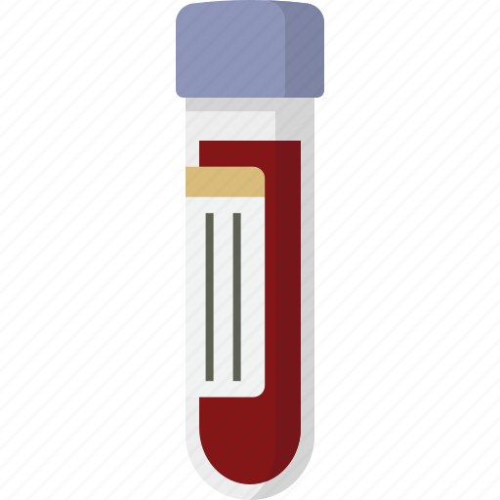
Motivation
What can antibodies and T-cell receptors (collectively, immune receptors) tell us about health
A milliliter (1ml) of blood:
1 million PBMCs (Peripheral Blood Mononuclear Cells) aka White Blood Cells): lymphocytes [B-cells: 15%, T-Cells: 70%]; monocytes, basophils, eosinophils, neutrophils: 5%; natural killer [NK] cells: 10%)*
3-6 million Red Blood Cells
*Numbers affected by health. Other tissues (lymph, tumors, …) are also analyzed.
References
https://www.ncbi.nlm.nih.gov/books/NBK2263/#:~:text=Red%20blood%20cells%20transport%20oxygen&text=Also%20known%20as%20erythrocytes%2C%20RBCs,through%20the%20smallest%20blood%20vessels.
https://www.ucsfhealth.org/medical-tests/wbc-count#:~:text=Normal%20Results,or%20may%20test%20different%20specimens.
https://www.ncbi.nlm.nih.gov/pmc/articles/PMC4549105/

Slide 3
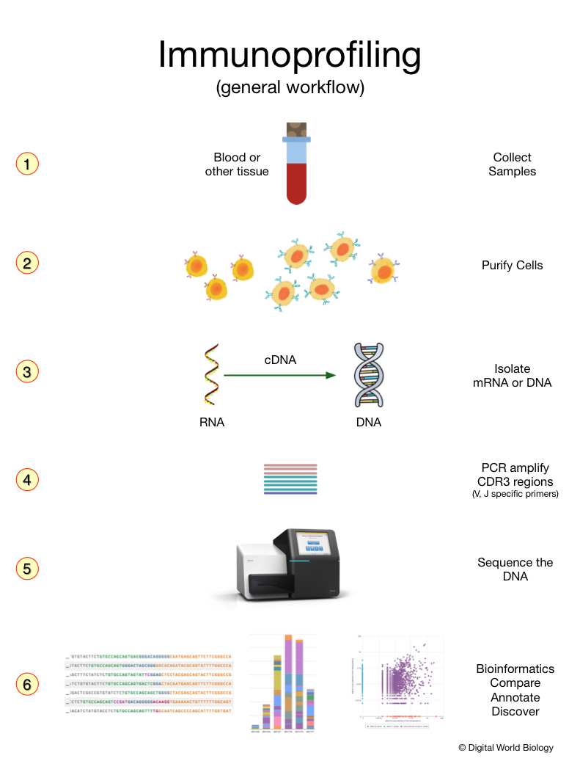
Immunoprofiling - Characterize Immune Receptors
DNA sequencing is used to assess the numbers of different B-Cells and T-Cells to measure:
Active infections, allergies
Cancer treatment, vaccine efficacy
Past disease exposure
Teaches concepts related to immune gene rearrangement (VDJ, VJ) and diversity, and cellular expansion (clonality).
https://digitalworldbiology.com/blog/what-immunoprofiling

Slide 4
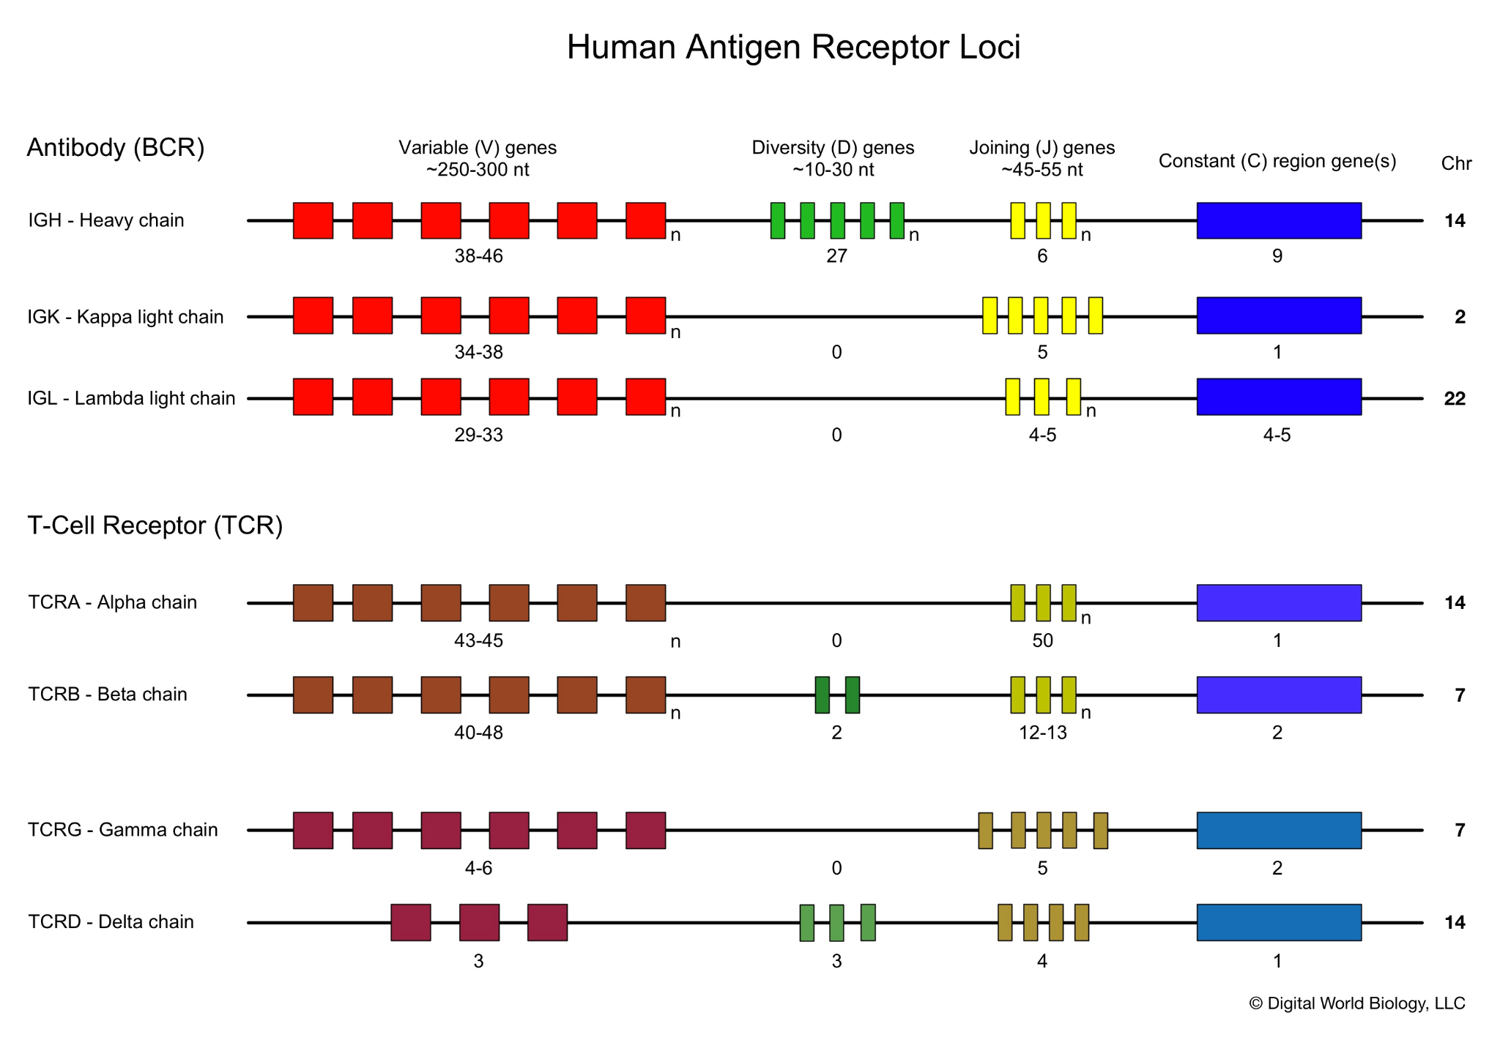
Antibody and T-Cell Receptor Genes and Loci
Pop Quiz
If an antibody has one heavy and one light (kappa or lambda) how many combinations are possible?
TCRs are either alpha/beta or gamma/delta, how many are possible?
How might diversity be increased?

Slide 5
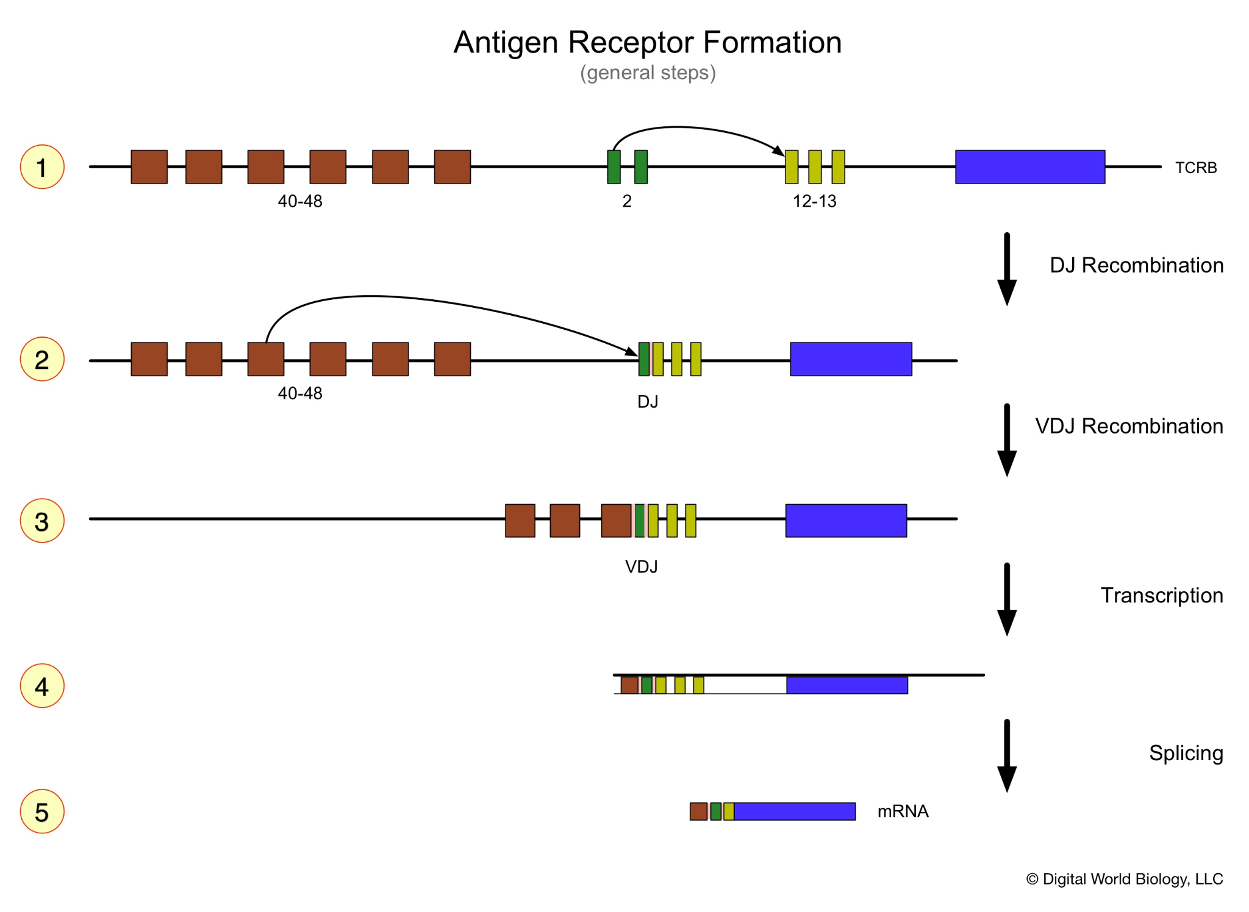
Antigen Receptor Gene Rearrangement Creates Diversity
Pop Quiz
It’s subtle but there are pink regions between the VDJ junction, what might those represent?

Slide 6
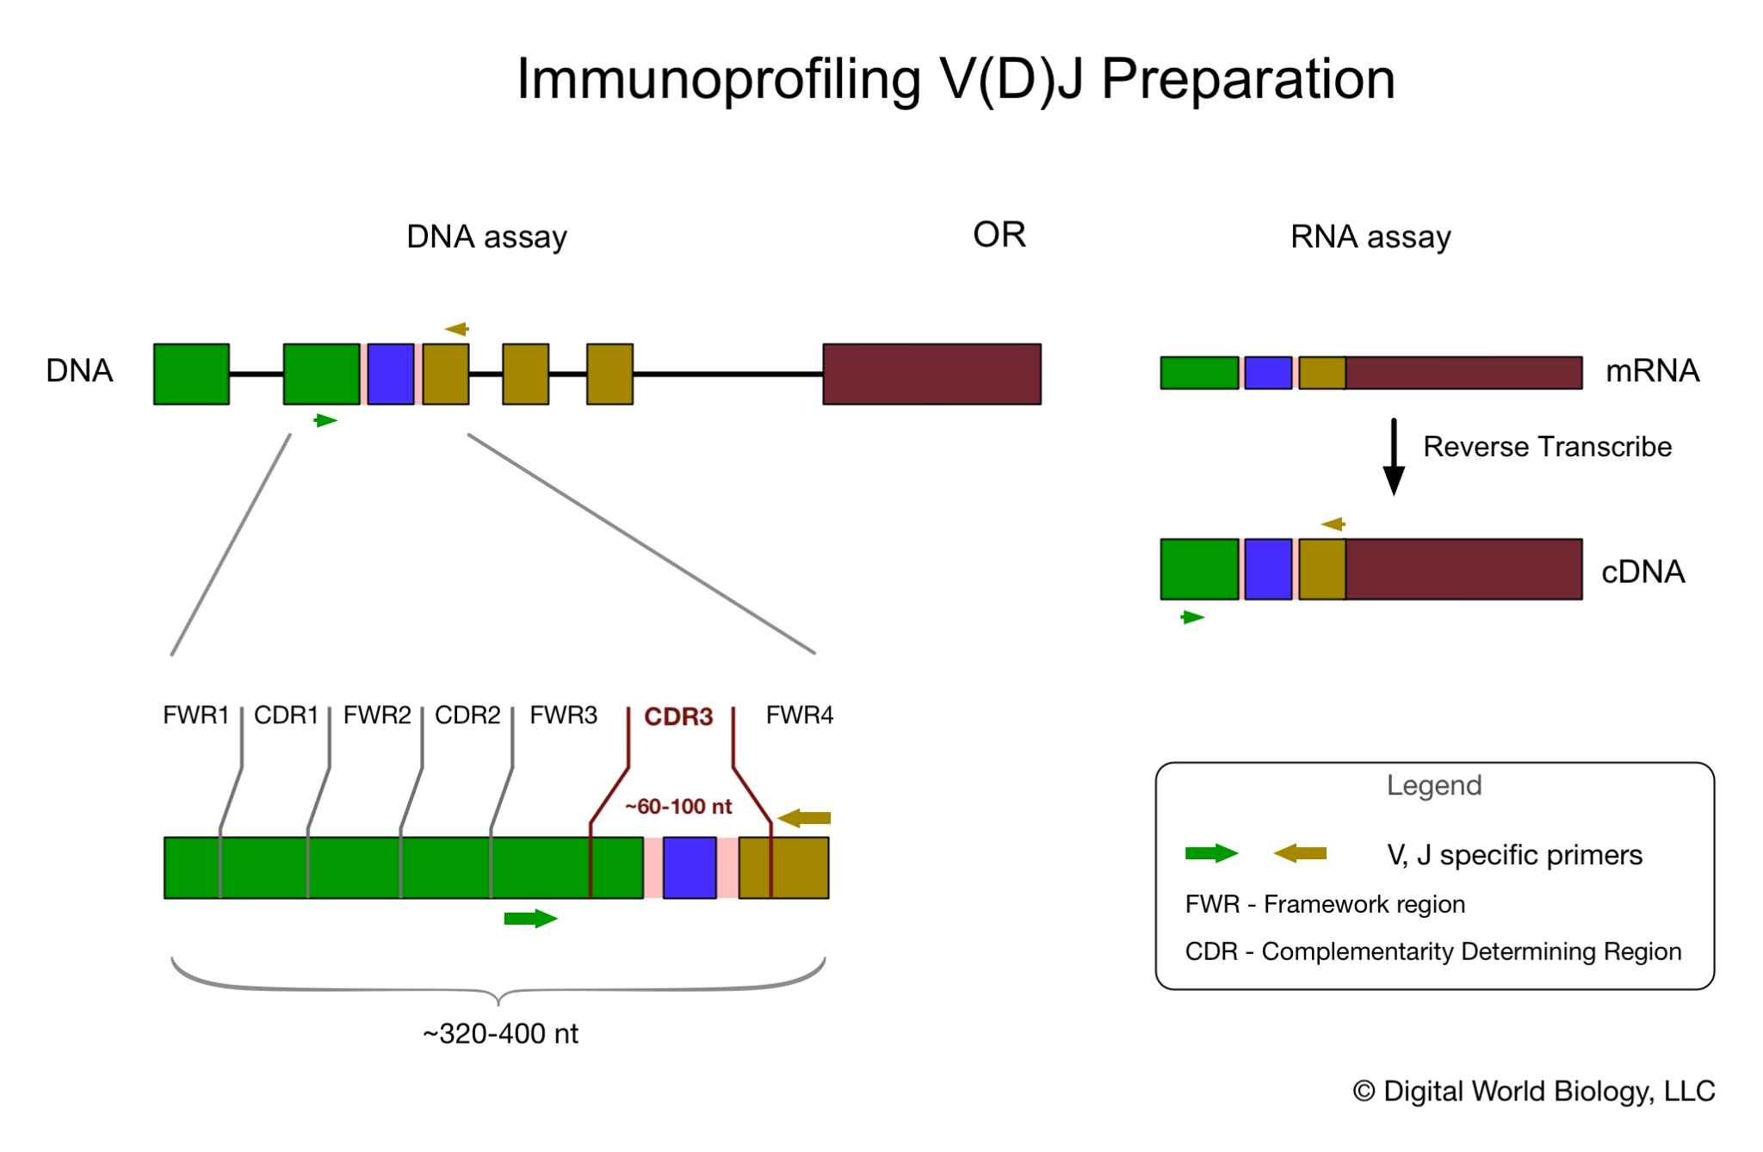
Basic Principal
Pop Quiz
How many primer pairs are need to sample the full diversity?
What could go wrong/bias the data?

Slide 7
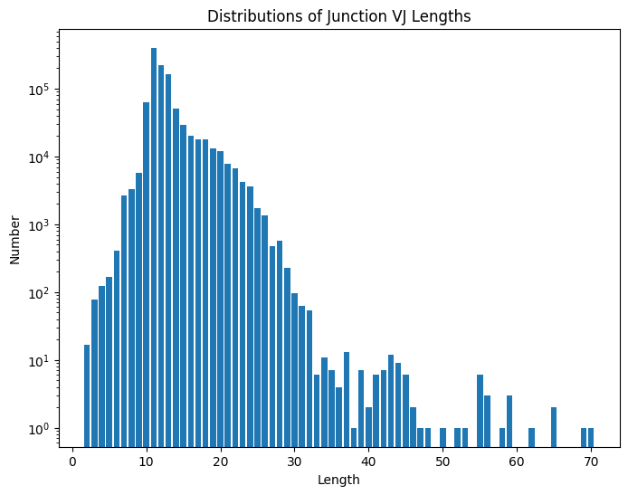
Clean and Reduce
Fastq paired files
Convert to fasta
Merge F/R reads
IgBLAST
Explore data

Slide 8
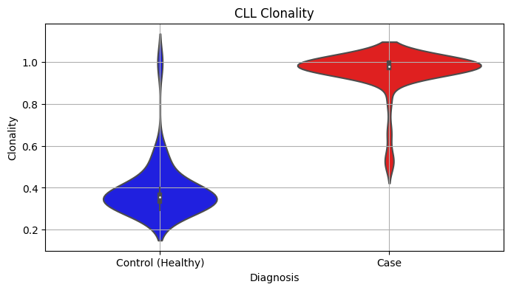
Compare and Discover
Meta data in json
Annotated data in TSV
> 1M sequences, 76 samples
29 Controls and 47 Cases
Chronic Lymphocytic Leukemia

Slide 9
Multi Part Project
Collect & Clean - Reduce - Compare - Discover
Upstream Bioinformatics
Acquire data, process into an immunoprofiling dataset
Learn how data are processed to forms that can used used in statistical analyses. Learn a few open-source tools and command line magic.
Data and databases
Quality assessment
Fastq to fasta
Paired sequence joining
Alignments and annotation (IgBLAST)
Table formats
Resource: Jetstream 2
Downstream Bioinformatics
Explore immunoprofiling data from a real world experiment
Learn about the end stage analyses. Sample comparisons, discovery. Test a prototype course module.
V-D-J analyses
Statistics and biological assessment
Breast Cancer dataset
Prototype course
Resources: ImmunoSeq Analyzer iReceptor

Slide 10
Gain Experience
Coding
Concepts
Data / Resources
Communication and Presentation
Jupyter notebooks
Python
SQLLite / SQL
Pandas
Data structuring
Plotting Data
AR diversity
Gene joining
N insertions
Clonality
Productive / non-productive
Data Exploration
Databases
Visualizations
Levels of data
Sequences
Annotated sets

Slide 11
Getting Prepared / Resources
Think about roles: Writer, data wrangler, coder, data analyst, reviewer.
Review materials @ https://antibody-engineers.org/blog/immunoprofiling-resources
Login to Slack, Join #5-immune_profiling
Set up an account on ImmunoSeq Analyzer - https://clients.adaptivebiotech.com/createAccount
A few days before - Aug 3, login to your account on Jetstream - see Slack for IP address and account information - ssh username@149.165.175.181, http://149.165.175.181:8000
Explore our Google drive -
Email me: todd@digitalworldbiology.com
Ask Questions!

